Slide 1

Dallas Bar Association
Solo and Small Firm Section
Traps in Trade Secret Litigation:
The Battleground in
Texas state courts
Michael K. Hurst
YAMAN DESAI

Slide 2

Litigating Trade Secrets in Texas Courts
Common Traps and Battlegrounds

Slide 3

Litigating Trade Secrets in Texas Courts
Common Traps and Battlegrounds
Rapidly Evolving

Slide 4

Litigating Trade Secrets in Texas Courts
Common Traps and Battlegrounds
Rapidly Evolving
Protecting Trade Secrets
in an Uncertain Economy

Slide 5
Litigating Trade Secrets in Texas Courts:
The Advent of TUTSA
Prior common law created differing approaches among courts
TUTSA provided stability and consistency
Pre-TUTSA cases still important

Slide 6
Distinctions between TUTSA and DTSA
TUTSA | DTSA
Subject only to fair notice pleading standard in state court Preempts common law claims dealing with misappropriation of confidential information Courts have enjoined employment, but cannot prevent use of “general knowledge, skill, and experience.” | Plaintiff likely must meet federal pleading standard Does not preempt state law claims Injunctive relief cannot be used to prevent employment relationship

Slide 7
Defining the Trade Secret:
Is the Information a Trade Secret?
“Trade secret” means all forms and types of information, including business, scientific, technical, economic, or engineering information, and any formula, design, prototype, pattern, plan, compilation, program device, program, code, device, method, technique, process, procedure, financial data, or list of actual or potential customers or suppliers, whether tangible or intangible and whether or how stored, compiled, or memorialized physically, electronically, graphically, photographically, or in writing, if:
(A) the owner of the trade secret has taken reasonable measures under the circumstances to keep the information secret; and
(B) the information derives independent economic value, actual or potential, from not being generally known to, and not being readily ascertainable through proper means by, another person who can obtain economic value from the disclosure or use of the information.
  Tex. Civ. Prac. & Rem. Code § 134A.002(6)

Slide 8

Defining the Trade Secret:
Is the Information a Trade Secret?
TUTSA list is non-exclusive.
Additional information can be a trade secret.
  See T-N-T Motorsports, Inc. v. Hennessey Motorsports, Inc.,
  965 S.W.2d 18, 22 (Tex. App.— Houston [1st Dist.] 1998, pet. dism’d).

Slide 9

Defining the Trade Secret:
Reasonable Measures
Non-comprehensive list of measures:
          Confidentiality or non-disclosure agreements
          Password protection
          Limiting access
          Secured rooms
          Check materials in and out
Do not need to implement all measures

Slide 10

The Future of Non-Competes
FTC voted to ban almost all non-competes
Judge Ada Brown (N.D. Tex.) issued preliminary injunction on July 3rd, blocking the rule only as to the plaintiffs

Slide 11

Defining the Trade Secret:
Independent Economic Value
Often prove monetary damages through expert testimony
          Developmental costs
          Reasonable royalty
          Lost profits
          Unjust enrichment
      Attorneys’ fees are not “actual damages”
  LaCore Enters., LLC v. Angles, No. 05-21-00798-CV, 2023 WL 2607562, at *9 (Tex. App.—Dallas Mar. 23, 2023, no pet.).

Slide 12

Defining the Trade Secret:
Not Generally Known
Does not mean absolute ban on disclosure
  See Lamont v. Vaquillas Energy Lopeno Ltd., 421 S.W.3d 198, 212 (Tex. App.—San Antonio 2013, pet. denied).
Trade secret protected even in absence of NDA where employee learned trade secret in course of employment
  See Fox v. Tropical Warehouse, Inc., 121 S.W.3d 853, 858 (Tex. App.—Fort Worth 2003, no pet.).

Slide 13

Defining the Trade Secret:
Not Generally Known
Public information can be a trade secret where the plaintiff performed significant work or undertook significant expense to identify and compile the information.
  See Eagle Oil & Gas Co. v. Shale Exploration, LLC, 549 S.W.3d 256, 269–70 (Tex. App.— Houston [1st Dist.] 2018, pet. denied).

Slide 14
Defining the Trade Secret:
Not Readily Ascertainable
“Reverse Engineering” means the process of studying, analyzing, or disassembling a product or device to discover its design, structure, construction, or source code provided that the product or device was acquired lawfully or from a person having the legal right to convey it.
  Tex. Civ. Prac. & Rem. Code § 134A.002(5)
Defendant must show ability to reverse engineer with sufficient precision.
  See IAC, Ltd. v. Bell Helicopter Textron, Inc.,
  160 S.W.3d 191, 198 (Tex. App.—Fort Worth 2005, no pet.).

Slide 15
Ownership of the Trade Secret
Open question in Texas
TUTSA provides broad definition of owner, including anyone with “rightful, legal, or equitable title to, or the right to enforce rights in, the trade secret.”
  Tex. Civ. Prac. & Rem. Code § 134A.002(3-a)
Other federal jurisdictions have not required ownership:
  See DTM Research, L.L.C. v. AT&T Corp., 245 F.3d 327, 333 (4th Cir. 2001).
  See Advanced Fluid Sys., Inc. v. Huber, 958 F.3d 168, 177–79 (3d Cir. 2020).

Slide 16
Making the Case for Misappropriation
Def. acquired trade secret and knew it was acquired w/ improper means; or
Def. used or disclosed trade secret w/o consent by someone who:
    Acquired knowledge of trade secret through improper means; or
    Knew (or had reason to know) that trade secret was:
              Derived from a person who used improper means to acquire
              Acquired under circumstances w/ duty to maintain secrecy
              Derived from person who owed duty to maintain secrecy
              Before material change in position, knew information was a trade secret and knowledge acquired by mistake
  Tex. Civ. Prac. & Rem. Code § 134A.002(3).

Slide 17
Making the Case for Misappropriation
The “mere fact that knowledge of a product or process may be acquired through inspection, experimentation, and analysis does not preclude protection from those who would secure that knowledge by unfair means.”
  Reliant Hosp. Partners, LLC v. Cornerstone Healthcare Grp. Holdings, Inc., 374 S.W.3d 488, 499 (Tex. App.—Dallas 2012, pet. denied).

Slide 18
“Use” as a Separate Element?
Split among Texas courts
Some have required use at trial (but not injunctive relief) stage
  See, e.g., Citizens, Inc. v. Riley, No. 03-19-00560-CV,
  2020 WL 5507281 (Tex. App.—Austin Aug. 31, 2020, no pet.).
Some federal courts have allowed circumstantial evidence of use
  See Stonecoat of Tex., LLC v. Procal Stone Design, LLC,
  426 F.Supp.3d 311 (E.D. Tex. 2019).

Slide 19

Starting Out with a Bang:
Seeking Injunctive Relief
Rapid, expedited, and high stakes

Slide 20

Starting Out with a Bang:
Seeking Injunctive Relief
Rapid, expedited, and high stakes
Significant costs

Slide 21

Starting Out with a Bang:
Seeking Injunctive Relief
Rapid, expedited, and high stakes
Significant costs
Considerable impact for both sides

Slide 22
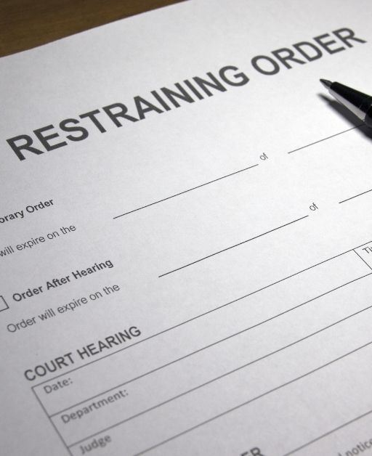
Starting Out with a Bang:
Temporary Restraining Orders
The element of surprise: Plaintiff ready while Defendant scrambles
Can be ex parte and without notice
Actual or threatened misappropriation may be enjoined
Generally not appealable

Slide 23
Starting Out with a Bang:
Temporary Injunctions
Have to establish probable, imminent, and irreparable injury
Plaintiff must show that monetary damages alone are insufficient remedy
  Butnaru v. Ford Motor Co., 84 S.W.3d 198, 204 (Tex. 2002).
Contractual stipulations are not dispositive
  See, e.g., W.R. Grace & Co.-Conn v. Taylor, No. 14-06-01056,
  2007 WL 1438544, at *2 n.7 (Tex. App.—Houston [14th Dist.]
  May 17, 2007, no pet.).

Slide 24
Starting Out with a Bang:
Temporary Injunction Orders
Make sure to spend time on the proposed order
Temporary injunction orders may be overturned where too broad or vague
  See Reliant Hosp. Partners, LLC v. Cornerstone Healthcare, 374 S.W.3d 488, 502 (Tex. App.—Dallas 2012, pet. denied).
Limited availability of mandamus, often related to free speech
  See Grigsby v. Coker, 904 S.W.2d 619, 621 (Tex. 1995).

Slide 25
Inevitable Disclosure Doctrine
Defendant has such knowledge of Plaintiff’s trade secrets that Defendant cannot perform work without using it
Texas has not adopted the Inevitable Disclosure Doctrine
  See DMG Servs., Inc. v. Figueroa, No. 01-16-00186-CV,
  2016 WL 7473947 (Tex. App.—Houston [1st Dist.] Dec. 29, 2016, no pet.).
But some courts have used a similar concept
  See IAC, Ltd. v. Bell Helicopter Textron, Inc.,
  160 S.W.3d 191, 200 (Tex. App.—Fort Worth 2005, no pet.).

Slide 26
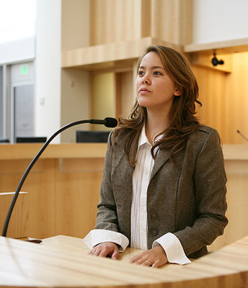
Proving Your Case Through Experts
Court acts as the gatekeeper
Generally substantive or damages
Must independently verify assumptions
  See Glattly v. Air Starter Components, Inc.,
  332 S.W.3d 620, 635 (Tex. App.—Houston
  [1st Dist.] 2010, pet. denied).
Need to explain methodology
  See Sw. Energy Prod. Co. v. Berry-Helfand,
  491 S.W.3d 699, 715–16 (Tex. 2016).

Slide 27
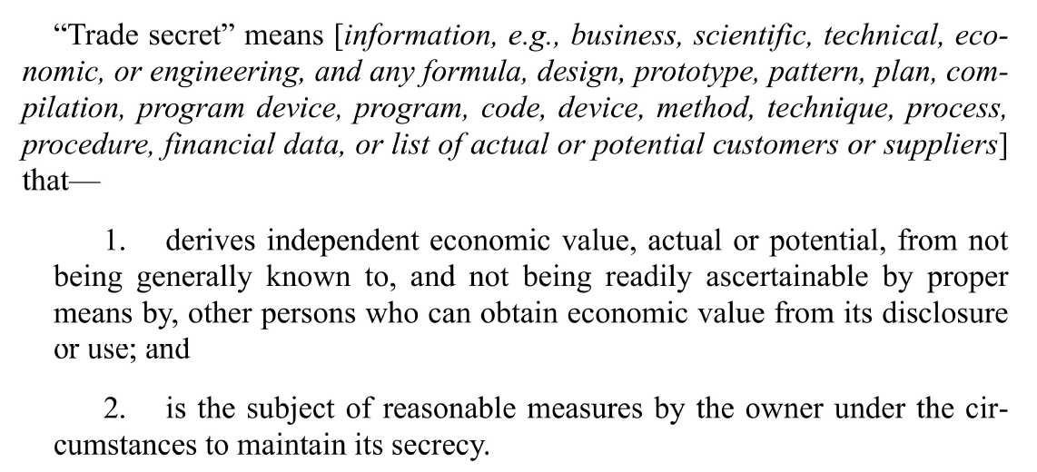
Drafting The Jury Charge
  Pattern Jury Charge 111.1

Slide 28
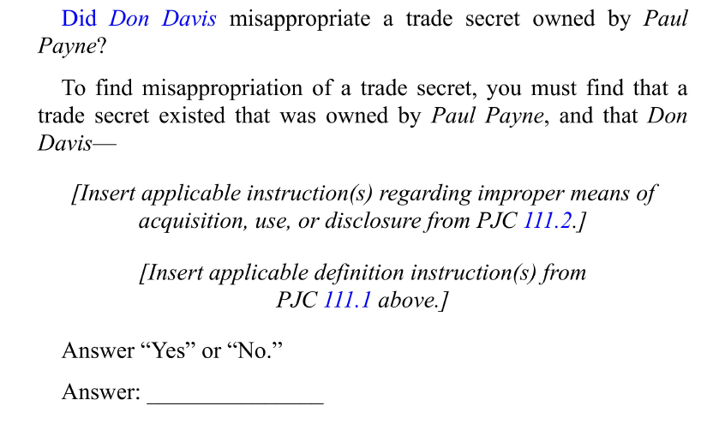
Drafting The Jury Charge
  Pattern Jury Charge 111.1

Slide 29
Presented By:
Michael K. Hurst
mhurst@lynnllp.com
YAMAN DESAI
ydesai@lynnllp.com

